Slide 1
SEATWORK 6.1 EXPLORATORY DATASET
Computational Thinking With Python
CPE311
Name: Calingo, Christian Lei S.
Section: CPE22S3

Slide 2
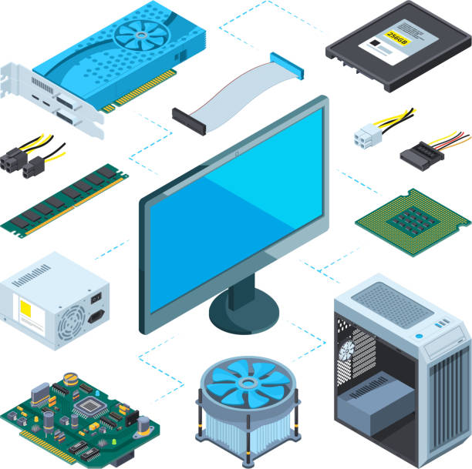
Analyzing the different prices of the computer components based on their category

Slide 3
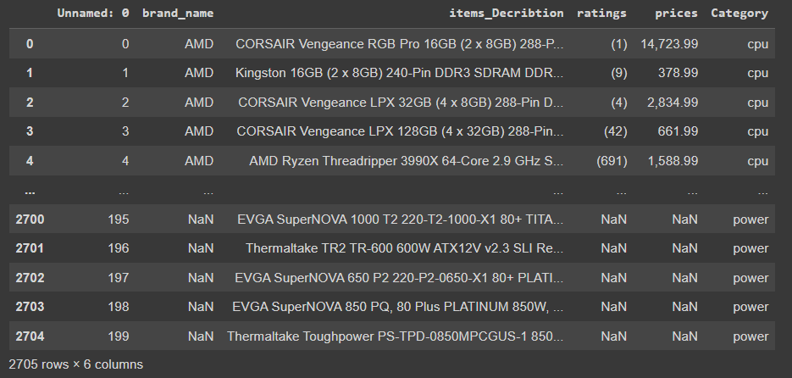
Datasets of the Computer Components

Slide 4

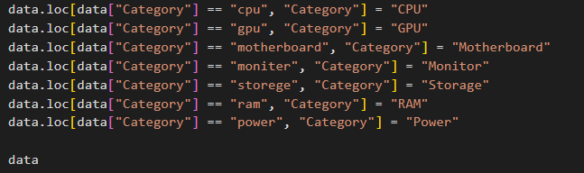
Changing the values in the category column due to typographical error

Slide 5
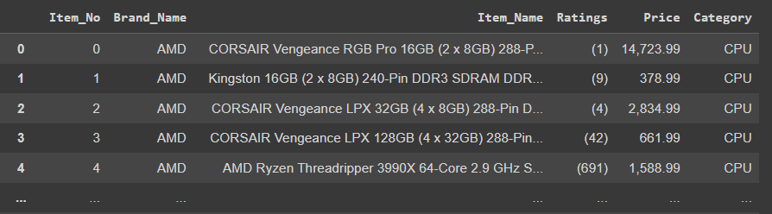
Changing the column names

Slide 6
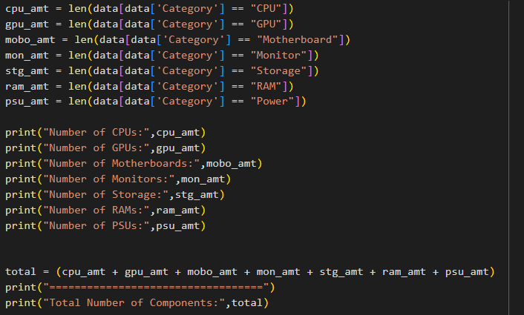
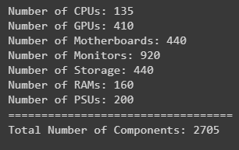
Changing the column names
Output

Slide 7



Creating a new data frame for each category

Slide 8



Creating a new data frame for each category

Slide 9

Creating a new data frame for each category

Slide 10

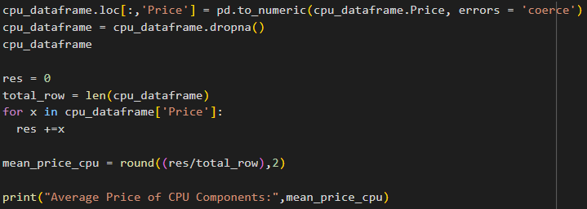
Deleting the rows with no prices and getting its mean

Slide 11
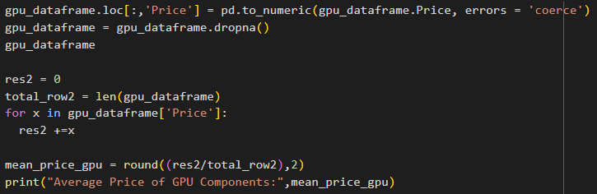
Deleting the rows with no prices and getting its mean

Slide 12
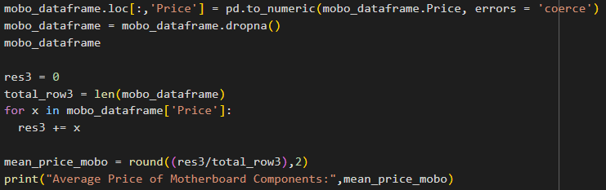
Deleting the rows with no prices and getting its mean

Slide 13
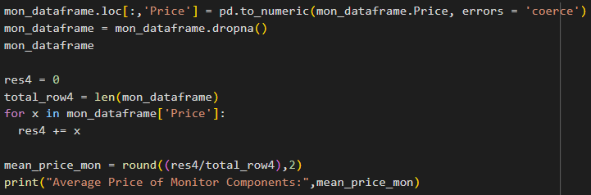
Deleting the rows with no prices and getting its mean

Slide 14
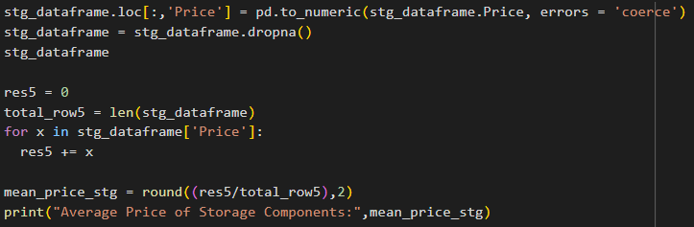
Deleting the rows with no prices and getting its mean

Slide 15
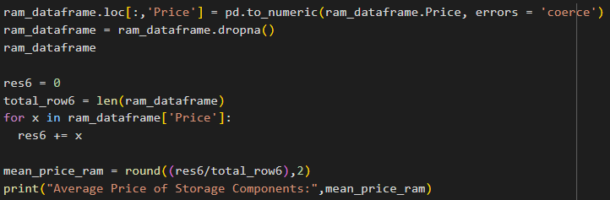
Deleting the rows with no prices and getting its mean

Slide 16
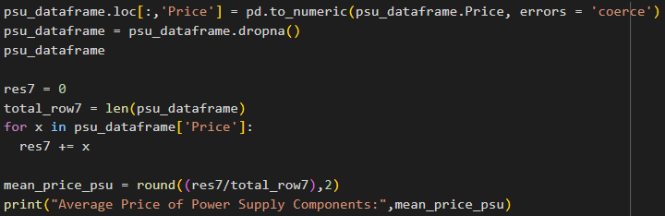
Deleting the rows with no prices and getting its mean

Slide 17
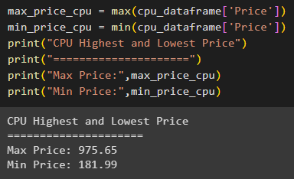
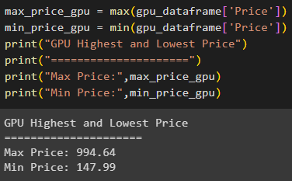
Max Price and Min Price of each components
CPU Components
GPU Components

Slide 18
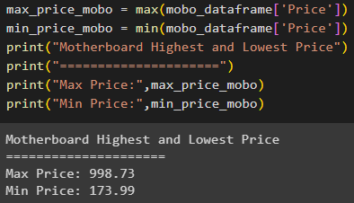
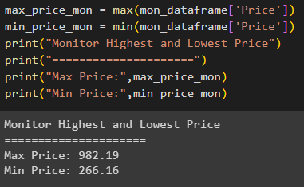
Max Price and Min Price of each components
Monitor Components
Motherboard Components

Slide 19
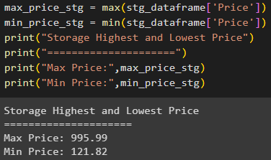
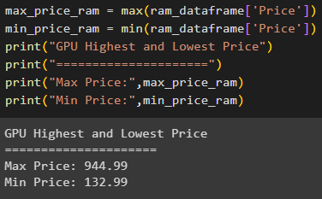
Max Price and Min Price of each components
Storage Components
RAM Components

Slide 20
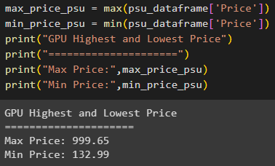
Max Price and Min Price of each components
PSU Components

Slide 21
CREDITS
Special thanks to all the people who made and released these awesome resources for free:
Presentation template by SlidesCarnival
Photographs by Unsplash

Slide 22
PRESENTATION DESIGN
This presentation uses the following typographies and colors:
Titles: Oswald
Body copy: Tinos
You can download the fonts on these pages:
https://www.fontsquirrel.com/fonts/oswald · https://www.fontsquirrel.com/fonts/tinos
You don’t need to keep this slide in your presentation. It’s only here to serve you as a design guide if you need to create new slides or download the fonts to edit the presentation in PowerPoint®

